Slide 1

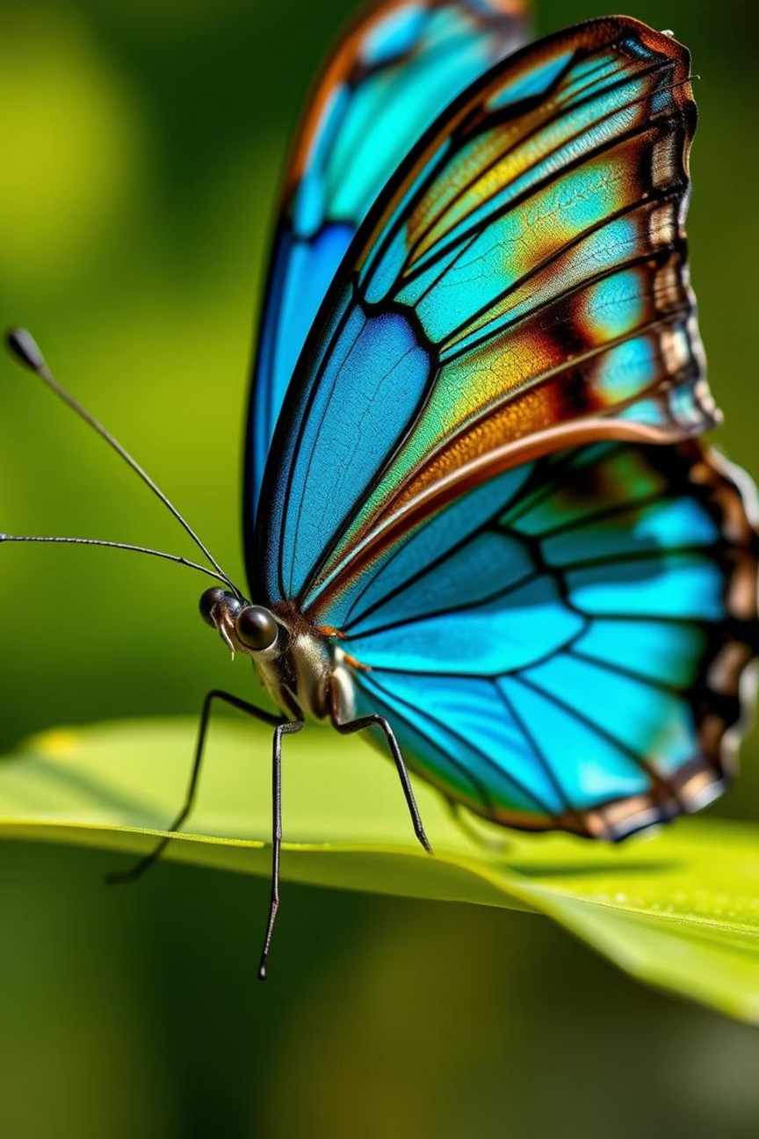

Enchanted Wings of Marvel: Butterfly Identification Project
Welcome to the "Enchanted Wings of Marvel" project, where we embark on a journey to revolutionize butterfly identification through the power of deep learning. Butterflies, with their delicate beauty and vital role in our ecosystems, present a fascinating challenge for accurate and efficient classification. This presentation will delve into how our project addresses this challenge, accelerating ecological research and bolstering conservation efforts worldwide.
TT
Notes:
1

Slide 2
The Challenge: Identifying Nature's Tiny Marvels
Complexity of Species
Time-Consuming Methods
With tens of thousands of butterfly species, each possessing unique yet often subtle visual characteristics, manual identification is an immense task. Many species exhibit sexual dimorphism, mimicry, or regional variations, further complicating accurate classification.
Traditional identification relies on trained experts, often requiring physical specimen collection, detailed morphological analysis under microscopes, or extensive field guides. This process is slow and resource-intensive, limiting the scale of biodiversity studies.
Expertise Dependency
Data Gaps
The scarcity of highly specialized entomologists means that many regions and projects lack the necessary human capital for comprehensive butterfly monitoring. This bottleneck hinders rapid response to ecological changes and emerging threats.
The challenges in identification lead to significant gaps in our understanding of butterfly populations, distribution, and migratory patterns. Without this crucial data, effective conservation strategies are difficult to formulate and implement.
Notes:
2

Slide 3




Project Overview: Leveraging Deep Learning for Classification
Our project, "Enchanted Wings of Marvel," directly addresses the problem of challenging butterfly identification by harnessing the power of deep learning. We are developing a robust classification model capable of recognizing diverse butterfly species from images, significantly streamlining the process for ecologists and researchers.
Deep Learning Core
Extensive Dataset
At the heart of our solution is a convolutional neural network (CNN) architecture, specifically designed to learn and extract complex visual features from butterfly images, enabling highly accurate species differentiation.
The model is trained on a meticulously curated dataset comprising thousands of high-resolution images across hundreds of butterfly species, ensuring comprehensive feature learning and generalization capabilities.
Image Input
Automated Identification
Users can simply upload an image of a butterfly, and our model will process it, providing an identification result within seconds, along with a confidence score.
This automation dramatically reduces the time and specialized knowledge required for identification, making it accessible to a wider range of users, from citizen scientists to professional ecologists.
Notes:
3

Slide 4
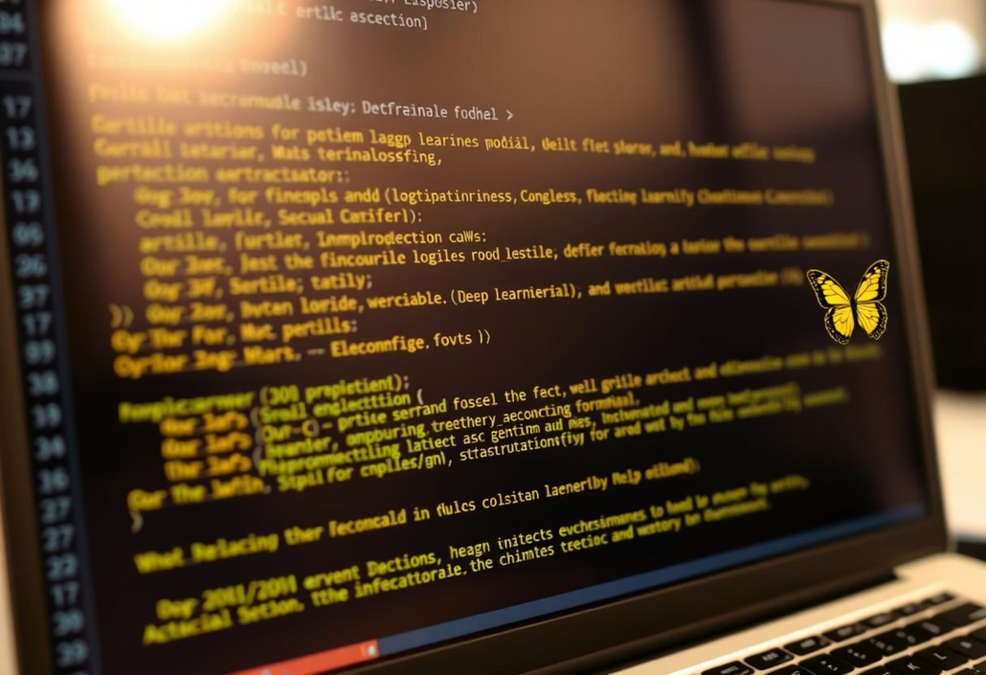
Methodology: From Pixels to Species
Our methodology is grounded in best practices for deep learning, focusing on a robust pipeline from data acquisition to model deployment. Each step is carefully designed to maximize the accuracy and reliability of our butterfly classification system.
Data Collection & Preprocessing
We gather images from diverse sources, including public databases, citizen science platforms, and collaborations with entomological societies. Images undergo rigorous cleaning, augmentation (rotation, scaling, cropping), and normalization to enhance model robustness.
Model Architecture Selection
After extensive experimentation, we opted for a transfer learning approach using a pre-trained ResNet-50 model, fine-tuning its final layers on our specific butterfly dataset. This leverages state-of-the-art feature extraction capabilities while minimizing training time.
Training & Validation
The model is trained using optimized learning rates and batch sizes, monitoring performance metrics like accuracy, precision, and recall on a separate validation set to prevent overfitting and ensure high generalization.
Deployment & Feedback Loop
Once validated, the model is deployed. We envision an integrated feedback mechanism where user corrections or new data can periodically retrain and improve the model's accuracy over time.
The iterative nature of our development process allows for continuous improvement and adaptation, ensuring the model remains cutting-edge and effective in an ever-evolving field of biodiversity.
Notes:
4

Slide 5




Impact: Accelerating Research & Conservation
The "Enchanted Wings of Marvel" project is poised to deliver significant benefits, transforming how we monitor and protect butterfly populations. By automating identification, we unlock new possibilities for ecological research and global conservation efforts.
Streamlined Ecological Research
Enhanced Biodiversity Monitoring
Researchers can rapidly process large volumes of image data, freeing up valuable time for deeper analysis, hypothesis testing, and uncovering new insights into butterfly behavior and population dynamics.
Our tool enables more frequent and widespread surveys, providing near real-time data on species distribution, abundance, and habitat health, crucial for understanding ecosystem changes.
Targeted Conservation Strategies
Empowering Citizen Science
Accurate identification helps pinpoint endangered species and critical habitats, allowing conservationists to deploy resources more effectively and develop tailored protection plans.
By making identification accessible, the project encourages public participation, transforming enthusiasts into valuable data collectors and fostering greater community engagement in conservation.
Notes:
5

Slide 6
Technological Innovations & Future Directions
Beyond its immediate application, this project lays the groundwork for further technological advancements and expanded capabilities. We envision a future where our butterfly identification model integrates seamlessly with broader ecological monitoring systems.
Real-time Field Identification
Predictive Modeling for Migration
Future iterations could include a mobile application with real-time image recognition, allowing immediate identification of butterflies directly in the field using a smartphone camera. This would revolutionize field surveys and citizen science contributions.
With vast datasets of identified species, we can train models to predict migration patterns, understand climate change impacts on butterfly populations, and even forecast potential pest outbreaks. This moves beyond identification to actionable ecological insights.
Integration with IoT Devices
Genetic & Behavioral Correlation
Imagine camera traps equipped with our AI model, autonomously identifying and logging butterfly occurrences, providing continuous, unmanned monitoring of remote or sensitive habitats. This could include solar-powered, low-power devices for extended deployment.
Integrating visual identification with genomic data and observed behaviors could unlock deeper understanding of species evolution, adaptation, and conservation needs, creating a holistic view of butterfly biology.
Notes:
6

Slide 7




Team & Collaborators
The "Enchanted Wings of Marvel" project is the result of dedicated effort from a multidisciplinary team. Our success is built upon a foundation of expertise in deep learning, entomology, and software development, further strengthened by invaluable collaborations.
Our core team combines diverse skills:
Lead Data Scientist
Entomology Advisor
Oversees model development, algorithm optimization, and data pipeline management, ensuring the highest accuracy and efficiency of the classification system.
Provides critical biological expertise, assists in data annotation, validates model outputs, and ensures the scientific rigor and ecological relevance of the project.
Software Engineer
Project Manager
Develops the user interface, backend infrastructure, and deployment mechanisms, ensuring a robust, scalable, and user-friendly application.
Manages timelines, resources, and stakeholder communications, ensuring the project stays on track and meets its objectives efficiently.
Notes:
7

Slide 8
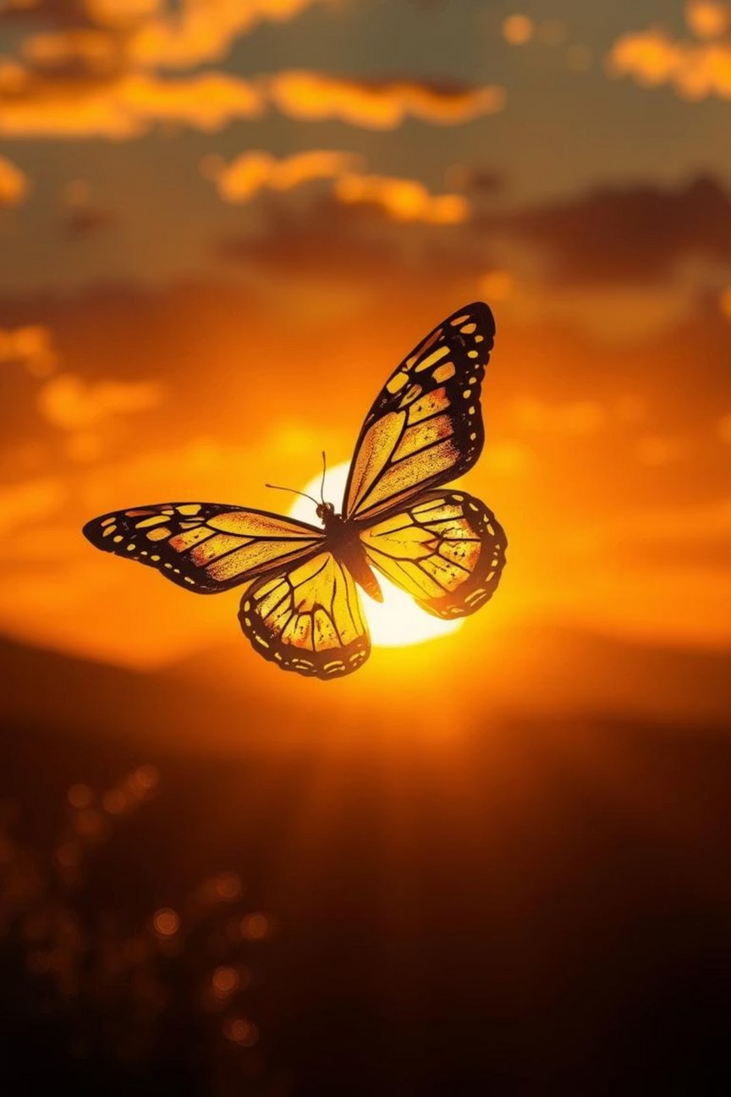
Key Takeaways & Next Steps
The "Enchanted Wings of Marvel" project represents a significant leap forward in butterfly identification. By automating this crucial task, we empower researchers, conservationists, and the public to contribute meaningfully to biodiversity protection.
Automated Accuracy
Broadened Impact
This tool will accelerate ecological research, enhance biodiversity monitoring, and enable more targeted conservation strategies worldwide.
Our deep learning model provides highly accurate and efficient butterfly species identification, moving beyond manual, time-consuming methods.
Future Potential
We are exploring integration with mobile apps, IoT devices, and predictive modeling for even greater ecological insights and conservation utility.
Notes:
8

